Slide 1

Group ID - G27 CHEST X-RAY ANALYSIS USING DEEP LEARNING ALGORITHM
Session 2022-23
Defining Seminar / Progress Seminar
Name of the Students
Bhavesh Verulkar (260)
Prathamesh Tonge (243)
Sankalp Thakre (229)
Shreya Balpande (239)
Pranjali Parshive (207)
Under the Guidance of
Mr.P.U.Tembhare
Assistant Professor
Department of Computer Technology

Slide 2
Contents
Overview
Related Work
Important & Needs of Your Project
Objective
Working Principal & methodology
Component Requirements
Construction Design
Calculation & Evolution
Result and Discussion
Conclusion
Future work

Slide 3
Overview
This technology is essential and critical for the examination, diagnosis and treatment of chest diseases, which is one of the main causes of death worldwide.
Reading X Rays requires careful observation and knowledge of anatomical principles, physiology and pathology.
Convolutional neural networks are the most widely used methods from Image recongnition.
Classify 7 different lung diseases using Chest Radiographs with high accuracy.
Disease prediction according to the symptoms shown by the patient we have built Database to Analysis.

Slide 4
Related Works (Literature Review)
In the MACS Laboratory paper Disease Prediction System several research groups have started to focus on the application of CNNs for chest X-ray classifications.
The database contain collection of records, focuses on optimizing latency, but at the same time, it also enables small networks to operate efficiently and support any size input, which can provide a better experience.
This database is currently one of the largest public X-ray databases, containing back-to-front and front-to-back thoracic films from 30,805 unique patients. Each image was annotated with as many as 7different thoracic pathological ethics, which were selected based on the frequency of observation and diagnosis in clinical practice.

Slide 5
Importance & Needs of the Project
Historically, Chest diseases are very serious health problems in the life of people . These diseases include consolidation, effusion, fibrosis, infiltration, mass, pneumonia, asthma and lung diseases.
The timely infections diseases have had civilization-altering consequences. so, diagnosis of chest diseases in the early stage is very important.
An X-ray is a quick, painless test that produces images of the structures inside your body and The study of major diseases from x-rays becomes a most challenging task

Slide 6
Objective
Making models deployment ready and cost effective.
Specialized models trained to classify diseases.
Diseases are often known to be medical conditions that are associated with specific signs and symptoms.
Accuracy is a measure to know how well or bad a model . Based on the current learning, evaluate the model on validation sets.
Machine Learning is also used for the healthcare industry to bring advancement in their techniques so that they can provide better services to their patients.

Slide 7
Working Principal & methodology
We want to predict the disease suffered by a patient depending upon the symptoms.
First step involves choosing the appropriate algorithm and representation of data in the form of the model. The cleaned data is split into two parts – train and test (proportion depending on the prespective); the first part (training data) is used for developing the model. The second part (test data), is used as a reference.
To test the accuracy, the second part of the data (holdout / test data) is used. This step determines the precision in the choice of the algorithm based on the outcome. A better test to check accuracy of model is to see its performance on data which was not used at all during model build.
This step might involve choosing a different model altogether or introducing more variables to augment the efficiency. That’s why significant amount of time needs to be spent in data collection and preparation.

Slide 8
Component Requirements
Software- Tensorflow , Flask(data base), Language-Python , kaggle, React.js
Hardware-Processor: i5
RAM: 8GB
ROM: 10GB

Slide 9
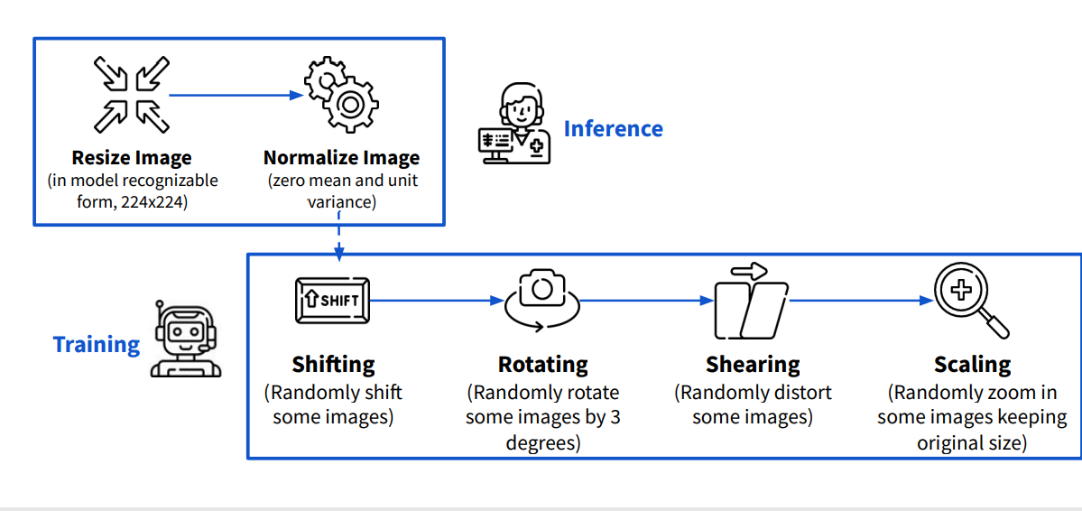
Design Parameter

Slide 10
Conclusion
Our models ability to cause severity lung infections could be used for escalation or de-escalation of care as well as monitoring treatment efficacy, especially in the intensive care unit (ICU).
Our results show that with the superimposition of the improvement steps, the overall performance of deep CNN models keeps getting better.
CNN(convolutional neural network) algorithm will have better performance using large amounts of data for the model training. Therefore, further study is expected to use a more significant amount of image data to produce a better performance model in image classification and object localization.

Slide 11
Result and Discussion (Expected Result)
Computing power and the availability of large datasets allowed this approach.
Our experiments investigated both the detection of lung abnormality and the diagnosis of specific TB symtoms among seven TB-related lung diseases (consolidation, effusion, fibrosis, infiltration, mass, pneumonia) from Chest-XR images via deep CNN models.
We recognize 800+ images of X-ray and predict 7 diseases or more.

Slide 12
Future work
Every one of us would like to have a good medical care system and physicians are expected to be medical experts and take good decisions all the time.
Predictive modeling uses AI to create a prediction from past records, trends, individuals, diseases and the model is deployed so that a new individual can get a prediction instantly.
Health and Medicare units can use these predictive models to accurately assess when a patient can safely be released.
Further study will also be expected to use x-ray image data with more classes of various diseases to be more helpful.

Slide 13
References
Classification and Predictions of Lung Diseases from Chest X-rays Using MobileNet V2,Article-18 March 2021.
(IJACSA) International Journal of Advanced Computer Science and Applications, Vol. 12, No. 10, 2021.
International Research Journal of Engineering and Technology (IRJET) Volume: 06 Issue: 05 May 2019
Sahlol, A.T.; Abd Elaziz, M.; Tariq Jamal, A.; Damaševiˇcius, R.; Farouk Hassan, O. A Novel Method for Detection of Tuberculosis in Chest Radiographs Using Artificial Ecosystem-Based Optimisation of Deep Neural Network Features-08 July 2020.

